Slide 1
Strategic Planning for Information Systems Section 12 Organizational Change, Culture and Strategic IS/IT Led Change Class Code: COMP423 H.Y Kan, Stanley Room: (WUI CHI) - 4/F, N46B Email: hykan@ipm.edu.mo Tel: 8599-6883

Slide 2
Learning Objectives
Develop an understanding of the need for organizational change, the key influence of human behavior and organizational culture in making it happen, and how to characterize organizational culture
Develop a critical awareness between tactical and strategic change and the organizational implications
Develop an awareness and critical understanding of how perceptions are formed and the approaches for changing these to effect strategic chanwg and manage resistance

Slide 3
Introduction
Change led by IS/IT or other business functions, begins with perception, which is shaped by one’s value, experiences, knowledge and interests.
Making organizational change happen is thus concerned with changing others’ perceptions of the operating environment so that they become supportive of and committed to creating the changes necessary for achieving the organization’s new goals and objectives.

Slide 4
Evolution of Organizational Change
To understand the importance of human behavior and organizational culture in affecting strategic change, it is necessary to briefly look at the evolution of organizational change.
Change is not something new. A Greek philosopher in the 6th century B.C. said “Nothing endures but change.”
However, recent ICT development has led to more rapid changes, creating operating environments that are increasingly unpredictable and discontinuous.
Business and product life cycles are reduced from years and months to weeks and days, where competitive rules can change quickly and significantly, and in which consumers are better informed and more demanding.

Slide 5
Evolution of Organizational Change (Cont’d)
The implications of these developments are far-reaching, particularly for incumbents.
Incumbents not used to the rapidly changing environment have geared towards efficiently and effectively managing the continuous improvement of their existing approach to making and selling goods and services.
This is reflected in their strategy, structure, and governance of people’s actions.
This approach however tends to result in corporate rigidity, inertia in thinking and operating, and under-performance when the organization gets out of sync with the market.

Slide 6
Evolution of Organizational Change (Cont’d)
Traditional strategy tools such as SWOT, five forces, PEST and Net Present Value analyses, and even the concept of sustainable competitive advantage, may be losing their relevance for all but the short-term as they are based on the ability to predict a path to the future through rigorous analysis.
Applying these tools can lead to the exclusion of key threats and opportunities from the strategic analysis, doing potentially more harm than good to the organization’s fortune.
Different strategic tools are thus needed, such as:
Scenario planning
Real options analysis

Slide 7
Evolution of Organizational Change (Cont’d)
The Traditional Linear, Supply-Push Approach
Core Capabilities
Goods and/or Services
Channels to market
The Customers
The Modern Demand-Led Approach
Customer Needs and Expectations
Channels to Market
Goods and/or Services
Core Capabilities

Slide 8
Evolution of Organizational Change (Cont’d)
In order to be more responsive to change, organizational decision-making authority and responsibility need to become decentralized where relevant.
The role of the strategic leader thus shifts from being a decision-maker to becoming a communicator who shapes the interactions between people and creates shared perceptions, purpose and meaning.

Slide 9
Class Exercise

Slide 10
Human Behavior
An individual’s behavior is to an extent shaped by the set of inherent, personal, social and organizational values that are acquired through upbringing, education, observations and experiences, including social influences.
These values are the enduring beliefs individuals hold to be true and important. As such, they affect an individual’s perceptions and govern their decisions and action.
People engage in saying one thing but doing something else more often than they are aware of or care to admit to. The reason is that this behavior is governed by a universal set of four values (inherited from our pre-human ancestors as a means to deal with threats):
Win and not lose the current situation at hand
Remain in control of the situation
Avoid any kind of embarrassment
Stay rational throughout the situation
Fear of failure leads to defensive reasoning (in accordance with the four governing values) and thus saying one thing but doing something else.
The plus side is that defensive reasoning enables quick yet safe decision-making in cases where we are familiar with the situation at hand and the expected outcome.

Slide 11
Organizational Culture
People live and work in communities – social, geographical, professional, organizational or industrial.
Therefore, communities have values; but also norms.
Norms are unwritten roles people use and follow to guide their behavior.
Typically, norms refer to such aspects of behavior as
Treatment of others
Conduct in certain company or circumstances
Importance attached to certain symbols or objects
To reinforce their values and norms, communities use stories, images, symbols (including language) and rituals such as processes, organizational structures and control systems.

Slide 12
Organizational Culture (Cont’d)
The combination of values, norms, beliefs and assumptions people commonly share with a community, take for granted and use to shape how they think and act is generally referred to as “culture.”
Culture fulfills four important needs people have, namely:
It provides a sense of stability as values hardly change over time
It provides a sense of identity
It acts as a filter, enabling sense-making
It communicates values to others
Many people are members of multiple communities. So, people typically have multiple “cultural frames of reference”. Views and expectations from different cultural frames may oppose each other.
This is important to keep in mind when initiating strategic change.

Slide 13
Characterizing Organizational Culture
An organization’s culture is intrinsically tacit, making culture as a concept abstract.
Characterizing an organization’s culture is therefore not straightforward and requires an indirect approach that uses a culture’s explicit manifestations, i.e., “cultural artefacts,” to infer the take for granted values, beliefs and assumptions.
In other words, one has to observe how the organization actually operates via:
The stories told
The symbols used, including language
The rituals and routines followed
The organizational and power structures present
The control systems used
Analysis of cultural artefacts provides an indication of the effort required to change the organization’s culture.

Slide 14
Getting the Organization Ready to Accept Strategic IS/IT Led Change
In order to succeed, change leaders need to overcome several challenges. Some are:
Change leaders must be respected and perceived by others as individuals with proven ability of delivering results that meet at least their basic expectation.
Change leaders must formulate a clear and compelling change message.
Change leaders have to overcome the perception of key managers, i.e., assisting them in identifying the underlying causes, acknowledging the need for change and buying into the change message.
Change leaders must keep the change message top of mind by frequently communicating, using all means possible what they set out to achieve, the underpinning reasons and urgency.
Organizational politics may be one major obstacle to change.
Top management support is the key success factor of change management.

Slide 15
Stakeholder Engagement
Top management support is not sufficient…
Ways to ensure harmonious stakeholder engagement:
Communication
Regular newsletters
Annual report
Periodic updates regarding key developments
Circulation of publications or publication list
Dynamic and static websites
Articles in sector press or local newspapers or in the academic literature

Slide 16
Stakeholder Engagement (Cont’d)
Ways to ensure harmonious stakeholder engagement (Cont’d):
Consultation/dialogue
Hold consultation meetings for the change
Hold open meetings to discuss policy or operational issues
Promote mechanism whereby stakeholders can provide feedback and feedforward to the change programme office on its services or activities
Involvement
Consider how key stakeholders can be represented on the management/steering committee
Create advisory, policy and interest groups to involve stakeholders more closely in the organization’s planning and decision-making of the change
Co-opt individuals onto the management committee for specific periods or purposes

Slide 17
Objectives of Change Management
Change management helps minimize the performance dip and accelerate performance improvement.
How to accelerate performance improvement?
Business Performance
How to minimize the performance dip?
Confidence
Denial
Exploration
Resistance
Time

Slide 18
Four-Phase Model of Managing Change
 | Users | Stage | Activities
1 | Denial | Launch: start as you mean to go on | Establish a partnership with your sponsor Build the user team Create a project branding
2 | Resistance | Communication: win hearts and minds | Define a communication plan Gather feedback Surface resistance Build communication skills
3 | Exploration | Education: skilling the end users | Design safe learning situations, e.g., pilots Develop task-based training with real data Build support mechanisms Train key users
4 | Confidence | After go-live: build on success | Catch problems early Stop and review, measure success Encourage ‘model’ behavior and build on the best practice

Slide 19
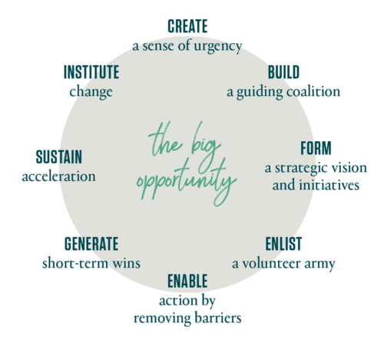
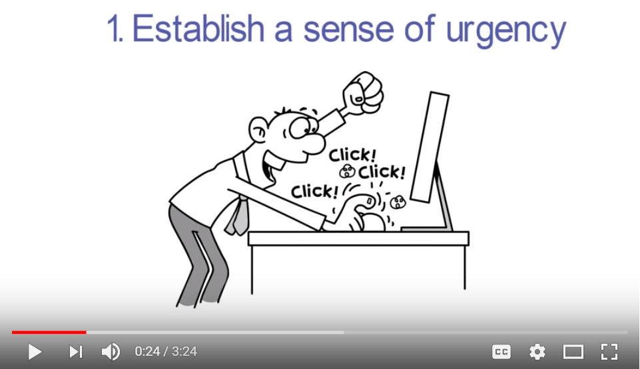
Kotter's 8 Step Change Model
YouTube Video
Source: https://www.kotterinc.com/8-steps-process-for-leading-change/

Slide 20
Factors Behind Failure of Change Initiatives
Failure of change initiatives is sometimes because communication of the change message, underpinning reasons and urgency by change leaders is limited both in frequency and actionable content. This may be due to “curse of knowledge.”
Once we know something, we find it hard to imagine not knowing it. We forgot that it took us (and will probably take others) a lot of time to understand the reasons for change.
Another reason for failure is that once change leaders have persuaded key managers of the need for strategic change and to buy into the change message, progress is slowed because of apparent lack of necessary resources.

Slide 21
Factors Behind Failure of Change Initiatives (Cont’d)
A third reason is that necessary changes have not been comprehensively identified, planned and/or executed.
The fourth factor that contributes to the failure of strategic change initiatives is that people will say they buy into the change message but their behavior and actions suggest otherwise.
This may be because reward schemes are tied strongly to today’s performance.
It may be a good idea to incentivize those who can persuade others to change.

